Slide 1
Neural Networks
Varol Kayhan, PhD

Slide 2
Introduction
Can we build an algorithm that "learns" like humans?
Can we mimic human brain?

Slide 3
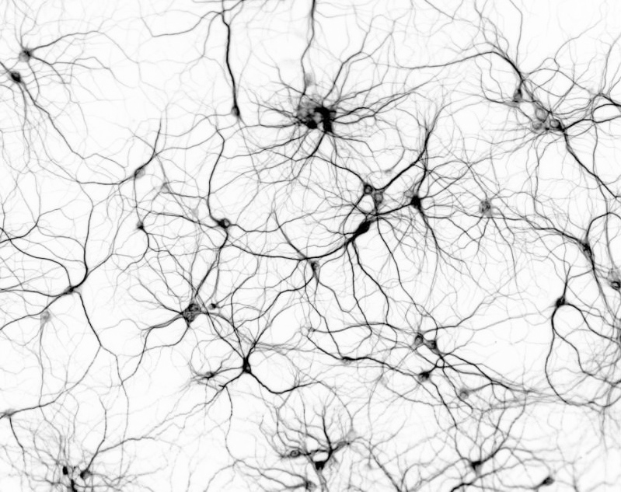
Biological Neurons
Source: http://www.thenanoage.com/forums.htm

Slide 4
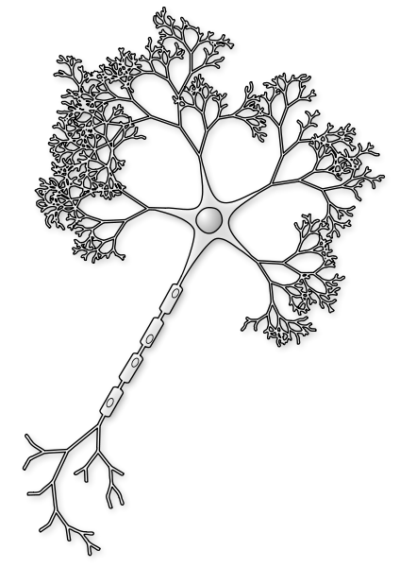
Biological Neurons
3
When cell excitement exceeds a threshold it "fires"
1
Inputs from other neurons
4
Electrical signal
Inputs can increase/decrease cell "excitement"
2
Picture source: http://commons.wikimedia.org/wiki/File:Neuron-figure-notext.svg

Slide 5
Neural Network
Example: predicting loan default
Input variables
Output
Age | Credit score | Kids | Default
30 | 750 | 2 | 0
45 | 800 | 1 | 1
… | … | … | …
… | … | … | …
… | … | … | …
Age | Credit score | Kids | Default
1.08 | 1.69 | 0.75 | 0
1.84 | 1.72 | 0.41 | 1
… | … | … | …
… | … | … | …
… | … | … | …
Standardize

Slide 6
Neural Network
Input layer
Output layer

Slide 7
Neural Network
Create "hidden" neurons:
Input layer
Output layer
Hidden layer

Slide 8
Neural Network
Establish “connections”:
Input layer
Output layer
Hidden layer

Slide 9
Neural Network
Add “bias” to each neuron:
Bias θ₁
Alternate diagram on the next page – they are the SAME!
Bias θ₂
Bias θ₃
Input layer
Output layer
Hidden layer

Slide 10
Neural Network
Bias
1
Add “bias” to each neuron:
Alternate diagram on the previous page – they are the SAME!
Bias
1
Input layer
Output layer
Hidden layer

Slide 11
Neural Network
Initialize all connections with random values:
0.01
0.013
0.024
Input layer
Output layer
Hidden layer

Slide 12
Neural Network
Initialize the bias values:
0.01
0.013
0.1
0.2
0.3
0.024
Input layer
Output layer
Hidden layer

Slide 13
Neural Network
TRAINING:
Send the first observation,
At each node:
Multiply the input values with initialized weights,
Sum the results and the bias term
Send the result to an activation function (that decides whether to fire off or not)
Compare the output value to the actual value (at the output layer)
Tweak the weights (using the backpropagation algorithm)
Increases the weights that lead to correct classification
Weaken the weights that lead to incorrect classification
Repeat for the next observation

Slide 14
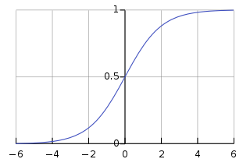
Neural Network
Activation function
Send the first observation
0.01
Age = 1.08
0.013
0.1
Credit = 1.69
Default = 1
0.2
Kids = 0.75
0.3
0.024
Input layer
Output layer
Hidden layer

Slide 15
Neural Networks
Actual training:
For first "epoch":
Divide the data set into "batches" (mini-samples)
Send the first "batch" through the neural network
Compare their true values with predicted values
Calculate the error
Tweak the weights and biases (using the backpropagation algorithm)
Send the next batch, and repeat…
Repeat for the next epoch (until you reach epochs=n)
Test:
Test the model on unseen data

Slide 16
Neural Network
0.017
Let's say, model accuracy on unseen data = 95%
Age
0.033
0.15
Credit
Default
0.22
Kids
0.4
0.027
Input layer
Output layer
Hidden layer

Slide 17
Neural Network
Send new observation
Neural Network Model
(a black box)
0.017
Age = 0.52
Prediction
0.033
0.15
Credit = 0.66
Default = 1
0.22
Kids = 0.02
0.4
0.027

Slide 18
Deep Neural Network
Layer 1
Layer 2
Layer 3
This is a
feedforward network
Input layer
Output layer
Hidden layers

Slide 19
Neural Network Architectures – Binary output
1
1
1
1
1
2
2
2
1
…
…
…
…
3
3
3
p
…
…
m
…
k
n
n
n
Perceptron
(no hidden layer)
Same as log.reg.
Scikit: SGDClassifier
Multi-layer Perceptron
(one hidden layer)
Scikit: MLPClassifier
Tensorflow: Keras
Multi-layer Perceptron
(more hidden layers)
Scikit: MLPClassifier
Tensorflow: Keras

Slide 20
Neural Network Architectures – Multiclass
E.g.: 3 classes
1
1
1
Softmax
1
Softmax
1
2
Softmax
2
2
1
…
…
…
…
3
3
3
p
…
…
m
…
k
n
n
n
Perceptron
(no hidden layer)
Multi-layer Perceptron
(one hidden layer)
Scikit: MLPClassifier
Tensorflow: Keras
Multi-layer Perceptron
(more hidden layers)
Scikit: MLPClassifier
Tensorflow: Keras

Slide 21
Backpropagation
Equivalent to gradient descent
Initialize W_{ij} and Bias
Send batch 1
Calculate the error
Go through each layer in reverse order,
Measure how much each neuron contributes to error
Gradient descent step
Repeat n times (i.e., n epochs)
Adjust W_{ij} and Bias
Send batch 2
Calculate the error
Repeat

Slide 22
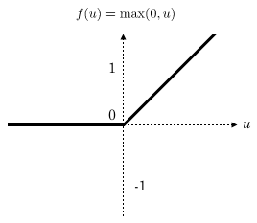
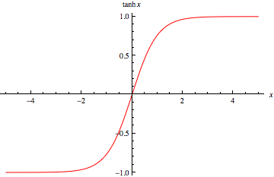
Activation functions
tanh
ReLU (rectifier linear unit)
Not differentiable at 0. Makes gradient descent bounce around. But still works well.

Slide 23
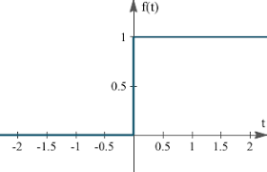
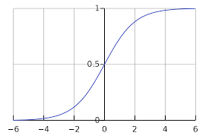
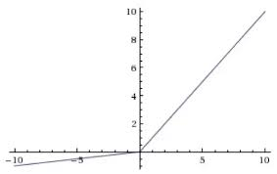
Other Activation Functions
Step
Sigmoid
Leaky ReLU

Slide 24
Neural Network
Can be built using different libraries:
Scikit: MLPClassifier (or MLPRegressor)
Tensorflow: Keras Dense Layer

Slide 25
Training using Scikit
High level API
Can build deep networks
Hyperparameter: hidden_layer_sizes = (100, )
Some other hyperparamaters:
activation
solver
alpha (L2 penalty)
learning rate
max_iter
etc.

Slide 26
Training using TensorFlow
Two choices:
Keras (higher level API)
Construct your own NN with every little detail including individual neurons!
Hyperparameters:
Number of layers
Number of neurons per layer
Type of activation function
Weight initialization logic
Learning rate
etc.

Slide 27
Fine Tuning Hyperparameters
How do you find a good set of hyperparameters
Trial-error
Grid search (with cross-validation)
Randomized grid search

Slide 28
Number of Layers
Start with 1 hidden layers
More than adequate in most cases
Can achieve high accuracy
More layers might result in overfitting!
If working with images: (Convolutional Neural Networks)
Might need hundreds of layers

Slide 29
Number of Neurons
Input and output layers are pre-determined!
Hidden layers are customizable
Funnel shape
Pipe shape
More neurons might cause overfitting!
Prevent overfitting:
Select a large number of hidden layers and neurons, then, use "early stopping"
Use L2 regularization (the "alpha" parameter)

Slide 30
Advantages and Disadvantages
Advantages:
Good performance
Can handle noisy data
Can capture complex relationships (isn't restricted to linear)
We don't "tell" the nature of relationships!
Disadvantages:
Black-box
Needs lots of data
No variable selection
Resource intensive

